Slide 1
Final Project
Presented By: Prajapati Maitri
Prajapati_M & K-State Honor Code: "On my honor, as a student, I have neither given nor received unauthorized aid on this academic work."

Slide 2

Project: Analysis on Movie Success Based on IMDB dataset
Key Task:
Cleaning data and create model
Identify key player in success of movie based on available data
Building different model and algorithm
Modeling , Evaluate and deploy different Models
Regression
Classification
cluster

Slide 3
Final Outcome:
Story Telling and Analysis of factor that play significant role in movie success based on different analysis and evaluation
Which model is better compare to other
Which data are not relevant to outcome
Recommendation

Slide 4
Regression Analysis
Model Development:
Linear Regression
Main Variable: imdb_score (on Y Axis)
Comparing variable : movies_facebook_likes
num_voted_users
cast_total_facebook_likes

Slide 5
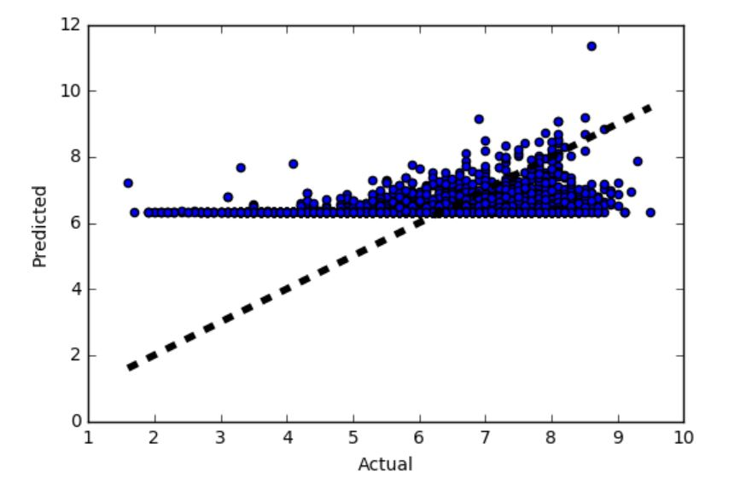
Outcome:
evaluating performance of our model's prediction using visualization
dotted line represents perfect prediction (actual = predicted)
This model shows minimize error
Higher Co efficient means fits well
movie_facebook_likes: Coefficients: [1.43867394e-05]
num_voted_users: Coefficients: [3.33886421e-06]
cast_total_facebook_likes: Coefficients: [5.31390516e-06] (Most fitting model)

Slide 6
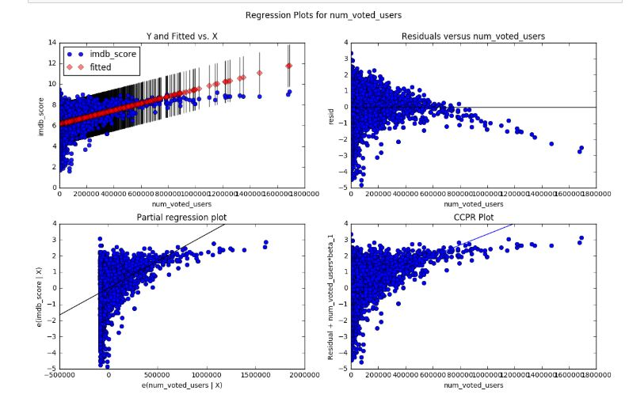
Regression using Statsmodels

Slide 7
Regression using Statsmodels
First model: movie_facebook_likes
Second model: num_voted_users
Third Model: cast_total_facebook_likes
The first model has a R-squared of 0.061.
The second model has a R-squared of 0.169.
The Third model has a R-squared of 0.007.
Based on this analysis, we could confirm that the second model model using num_voted_users is a better model.

Slide 8
Multiple Regression using Statsmodels
The first model has an Adjusted R-squared of 0.194, with 95% confidence interval of num_critic_for_reviews between -0.005 and 0.822. This is counterintuitive, since we expect the num_critic_for_reviews value to be positive. This is due to a multicollinearity between the variables.
The second model has an Adjusted R-squared of 0.202, and the last model an Adjusted R-squared of 0.037.
Based on this analysis, we could confirm that the second model using aspect_ratio and num_voted_users is the best model for predicting movie's success.

Slide 9
RandormForestRegressor for Feature Selection
Top Variable
'aspect_ratio'
'facenumber_in_poster'
'movie_facebook_likes'

Slide 10
Prediction Based on RandomForestRegressor for Feature Selection
'aspect_ratio'
'facenumber_in_poster'
'cast_total_facebook_likes'

Slide 11
Classification
Decision tree
Here WE created data in 4 different category and distributed by bad, okay, good, Excellent
split validation
Train a decision tree model
Model evaluation
Using different matrix for (shows in picture on next slide)
accuracy_score
confusion_matrix
classification_report

Slide 12
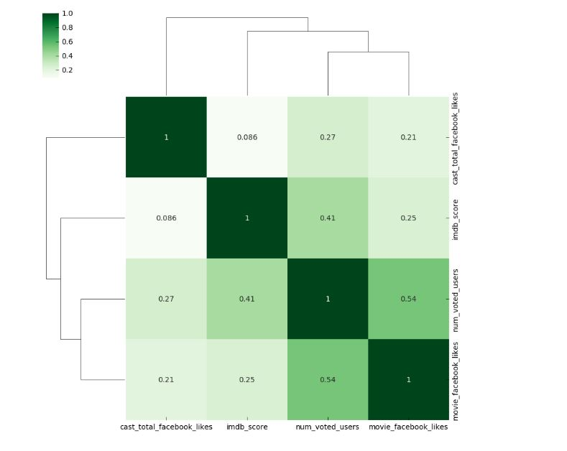
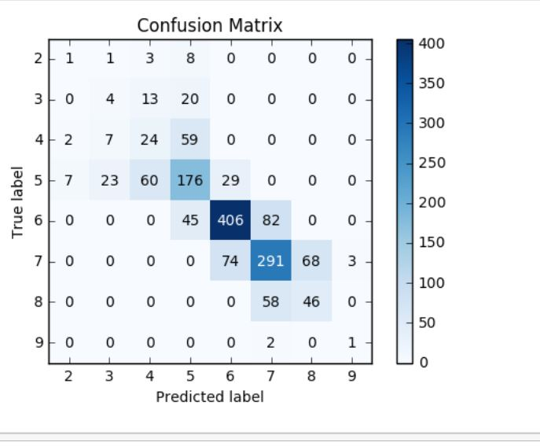
Findings from decision tree model

Slide 13
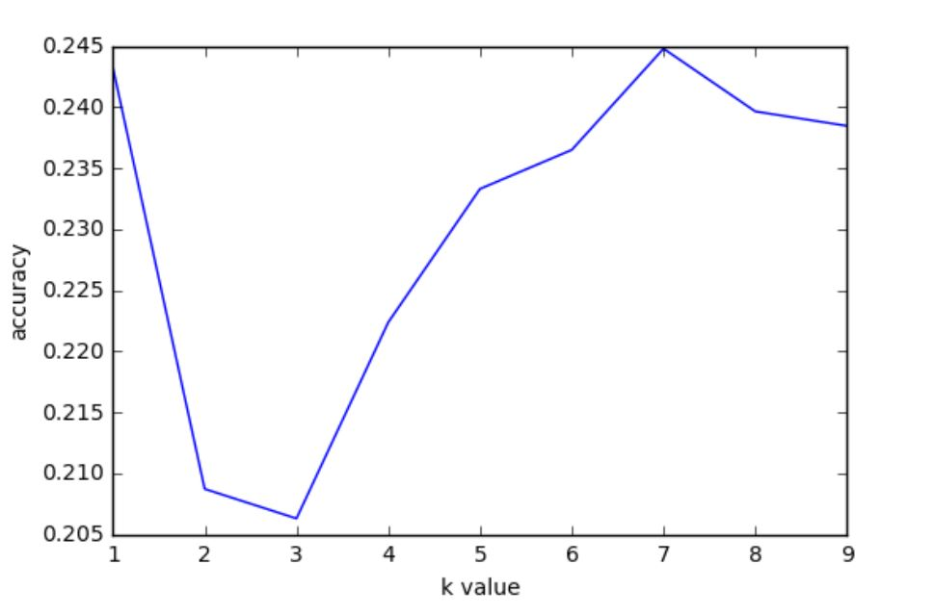
Model evaluation with valdation
KNeighborsClassifier
10 fold cross validation
Search for the optimal k value (GridSearch)
validating classification model
cross_val_score
GridSearchCV
Best score, parameter and best estimator is neighbor 7 which is based on num_voted_user

Slide 14
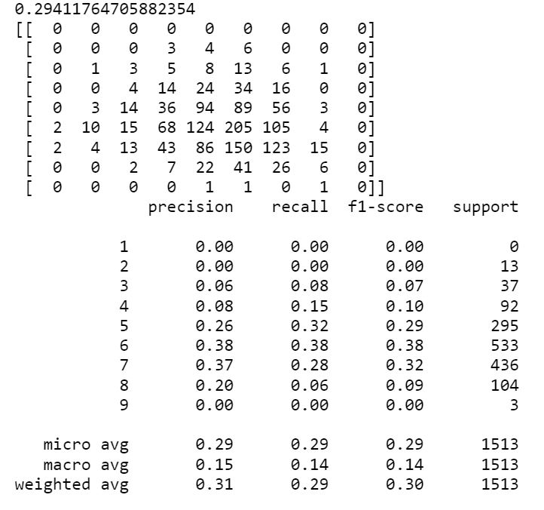
Model evaluation without validation

Slide 15
Model Evaluation with ROC
This method does not support since it requires binary formatted data.
In other words it does not support multiclass data and requires only few
Category, which I could not supply in this dataset.
Handling Categorial Columns (or Variables) - One Hot Coding
One of the easiest method
LogisticRegression model gives accurate data and we can validate which variable is going to affect more likely and which will not.

Slide 16
Model Building & Validation with "Feature Selection"
SelectKBest
We can save data with 4 different category assigned earlier.
develop logistic regression model with X_new (only three predictors or independent variables)
Extra tree classifier: Tree-based feature selection
Features sorted by their rank:
actor_1_facebook_likes
facenumber_in_poster
aspect_ratio
actor_2_facebook_likes
actor_3_facebook_likes

Slide 17
Conclusion on Classification
All three classification algorithms (decision tree, logistic regression, knn) work well for this dataset
It shows us which feature are going to work well in success of movie or getting higher IMDB Ranking
Some of them are Actors, number of poster on facebook, number of likes on facebook
Some of variable are not going to help much such as budget, director

Slide 18
conclusion on cluster Analysis
Using normalization, Hierarchical Clustering Dendrogram and sample of 4 cluster helps to predict better score and variable that are going to work such as cast liked on facebook or number of reviews.
Algorithms shows positive relationship and cluster around variable that are going to work better.
They also shows some of the variable like, budget, director, language are not going to affect as much.

Slide 19
Final Recommendation:
All different models and algorithms help to find different solution and most of them works accurately.
It shows positive relationship with different variable and imdb score. higher the score of variable, higher the imdb rank.
Which also means that more positive relationship, more chance of success in future based on those variable.
cast that are more liked on facebook, movie that are more liked on facebook, higher reviews helps a lot in success of movie as well as predicting future data or success. Those are the variable that needs to focus more.
Some of findings also suggest that poster on facebook tend to work as well so I would recommend to advertise more on above variable on facebook and encouraging people to rate more on facebook can help significantly.
Duration, language, director, budget are not going to make significant difference, there for it will be better if we do not focus on those variable.

Slide 20
Thank you

